Slide 1
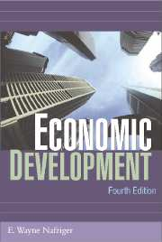
Chapter 5
Theories of Economic Development

Slide 2
Theories of economic development
Theory – systematic explanation of interrelationships among economic variables.
Purpose – to explain causal relationships among these variables, to understand world better and provide basis for policy.

Slide 3
Theories in Chapter 5
Classical (19th century English) model
Marx’s historical materialism
Rostow’s stages of growth
Vicious circle theory
Balanced v. unbalanced growth
Coordination failure (O-ring theory)
Lewis-Fei-Ranis model
Baran’s neo-Marxism
Dependency theory
Neoclassicism (Washington Consensus)
Solow’s neoclassical (Mankiw-Romer-Weil human capital variable)
New (endogenous) growth theory

Slide 4
Classical theory
Natural order determines price, rent, & economic affairs.
Competitive economy promotes public interest.
Freedom from government restriction.
Institutions to supply money.
Capital accumulation (savings) – output – wages.
Division of labor – related to market size.
cont.

Slide 5
Classical theory (Cont)
Free trade.
Diminishing returns.
Iron law of wages.
Formulated amid scientific discoveries & technical change.
Major flaws – population theory & lack of technological change.

Slide 6
Marxism
Historical dialectic – examines where society was, is going, and its change process.
Movement from feudalism to capitalism to socialism – based on changes in ruling & oppressed classes & their relationship to each other.
Reserve army of unemployed.
Can socialism be introduced through parliamentary democracy?

Slide 7
Critique of Marxism
Discussion of socialism not well developed.
Worker revolt is weakest link.
Overlooked possibility that workers’ & capitalists’ interests don’t conflict.

Slide 8
Why didn’t Western workers overthrow capitalism? Marxist explanation
Divide & rule.
Exploitation of LDC workers.
Media, education, religion support capitalist ideology.
Powerful legal, police, military, & administrative machinery.

Slide 9
Marxism & its variants
Yet Marxism remains rallying point for discontented people.
Class antagonism threat to rulers of any economic system.

Slide 10
Legal, institutional & political framework, social consciousness
Economic structure of society (material forces of production)
  Existing rationality, science & technology
  Mode of organization of production
  Degree of development of people
Relations of production
  Appropriation of human labor product
  Social contradictions under which production takes place
  Principles of distribution
  Modes of thought, ideology, and Weltanschauung
Marx’s economic interpretation of history

Slide 11
Rostow’s stages of economic growth
Traditional society.
Preconditions for takeoff.
Takeoff.
Drive to maturity.
Age of high-mass consumption.

Slide 12
Rostow’s traditional society
Pre-Newtonian or 18th century.
Lumps past economies, DCs 19th century, & LDCs today together.
Neglects dualism of many low-income countries today.

Slide 13
Rostow’s preconditions stage & radical change outside industry
Increased transport investment – enlarge market & specialization.
Agricultural revolution to feed urban population.
Expansion of imports (especially capital), perhaps financed by exporting natural resources.

Slide 14
Rostow’s central stage, takeoff
Decisive expansion 2-3 decades.
Radically transforms economy & society.
Barriers to steady growth overcome.
Late 18th-century Britain, pre-civil war US, late-19th-century Germany, post-Meiji (1868) Japan, pre-1917 Russia, post-independence India & post-1949 China.

Slide 15
Rostow’s 3 conditions for takeoff
I/NNP increases sharply, say 5 to 10%.
Leading manufacturing sector stimulates growth through linkages.
Political, social, & institutional framework to exploit modern expansion: entrepreneurship, retained earnings, banks & capital markets, foreign investment.

Slide 16
Rostow’s drive to maturity
Growth regular, expected & self-sustained.
Urban, skilled, less individualistic, more bureaucratic labor force.
State provides more economic security.

Slide 17
Age of high mass consumption
Alternative: welfare state, military power.
US 1920s, Western Europe 1950s.
Autos, suburbs, innumerable durable consumer goods & gadgets.

Slide 18
Critique of Rostow
Lack of empirical evidence (increase investment rates).
No historical evidence of abruptness.
Difficult to test.
Stages define not explain.
Stages not unique.
Dualism (not just pre-science & technology).
How does an economy move to next stage?
Does self-sustained growth imply effortlessness? Are obstacles to growth removed?
Is this Western (or US) model in disguise?

Slide 19
Vicious circle theory
Supply side - Because incomes are low, low propensity to save for capital formation, which results in low productivity per person, which perpetuates low levels of income.
Demand side – Because incomes are low, market size is too small to spur investment.

Slide 20
Critique of vicious circle
Saving depends on relative income.
Personal savings small percentage of total savings.
Large-scale economies overrated. Market is ample for most goods. Economies of experience important.

Slide 21
Balanced growth advocates
Meaning of balance.
Balanced growth – synchronized application of capital to wide range of different industries – Nurkse.
Big push needed because of indivisibilities – of infrastructure & demand – Rosenstein-Rodan.

Slide 22
Critique of balanced growth
Agricultural investment needed.
Infrastructure not so indivisible.
Economy that can undertake balanced growth is not underdeveloped - capital, skills, materials needed are immense.
Not starting from scratch.
Growth in 1960s & 1970s without massive investments.

Slide 23
Hirschman’s strategy of unbalance
Major shortage is investment by entrepreneurs & risk takers.
Need development strategy to spur investment decisions.
Need to consider how investment affects profitability of other sectors.
Spur investment decisions through linkages – backward to sales of inputs & forward to purchases of inputs.

Slide 24
Critique of unbalanced growth
Too little emphasis on agriculture – contributes to industry through food, foreign exchange, labor, capital & larger markets.
Imbalances should have ultimate balance in mind.

Slide 25
O-ring theory of Economic Development - Kremer
Based on 1986 shuttle Challenger.
All of thousand components must work for the Challenger to function.
Taiwan & Korean governments intervened to provide coordination.
Human capital important.

Slide 26
Lewis model
Explains how economic growth gets started through structural change – increase in size of the industrial sector relative to subsistence agricultural sector.
Lewis concerned about labor shortages in expanding industrial sector.

Slide 27
Lewis model (cont)
Assumes MP_{L}AG = 0.
Wages low but positive.
w_{K} higher includes inducement.
Capitalist hires to MRP_{L} = w_{K}
Surplus above wage is saved & reinvested.
Increases productivity; more workers hired.
When labor no longer available, w_{T}
Growth from structural change & savings.

Slide 28
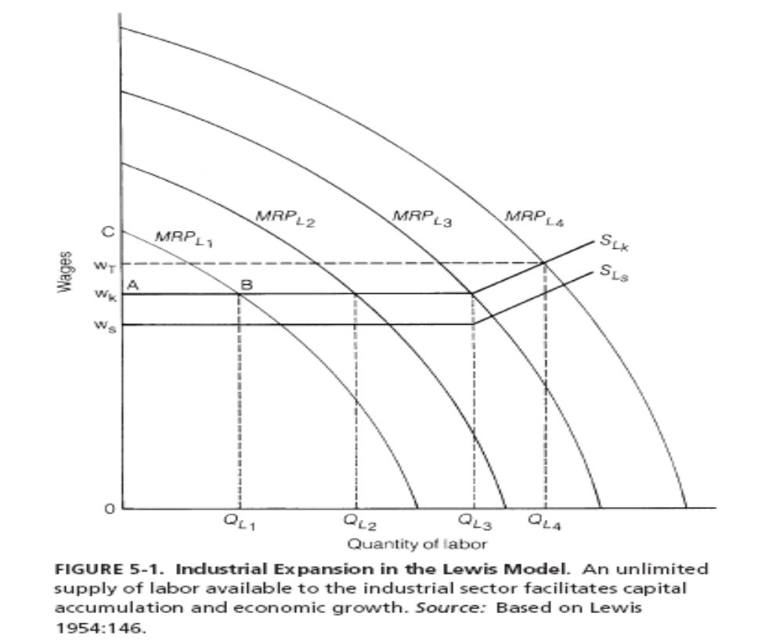

Slide 29
Critique of Lewis model
MRP of labor in agriculture.
Unlimited supply of labor in agriculture.
As labor migrates, constant output divided among less claimants.
Food prices increase from more demand from urban sector.
Increased wages sooner than Lewis assumption.
Not realistic to assume only urban sector saves.

Slide 30
Fei-Ranis modification
w_{k} institutional wage.
When MRP_{L}ag = w, commercialization point & industry pays market rate.
Each migrating worker takes subsistence to industrial sector – unrealistic.
19th-century Meiji Japan - paid less than subsistence wage.
Eventually w_{k} had to be increased to cover increased demand for labor & increased food price.

Slide 31
Lewis-Ranis-Fei
Supply curve for labor is not infinitely elastic.
To get more labor, you need to pay a higher wage.

Slide 32
Baran’s Neo-Marxist Thesis
Application of Marxism to Africa, Asia, & Latin America.
Western economic & political domination unfavorable.
Western monopolistic business transferred to LDCs.
Bourgeoisie in LDCs too weak to accumulate capital & provide institutional change.

Slide 33
Baran - coalitions in LDCs
Bourgeoisie ally with moderate leaders of workers & peasants.
Form New Deal coalition – democratic, antifeudal, anti-imperialist, supportive of indigenous capitalists.
Indigenous middle & capitalist classes unwilling or unable to reduce poverty and provide economic development for masses.

Slide 34
Baran’s dynamics
Bourgeoisie frightened & forced into alliance with landed interests & foreign capitalists.
Government supported by foreign economic & military assistance.
Progressive coalition breaks down.
Overriding interest in preventing socialism.
Needed: progressive income tax; landlords invest productively, public investment where private capital does not venture or where monopolies or where infrastructure required.
Impossible – populist forces further polarization, radicalism & revolt.
Impasse broken by expropriation & ethos of collective effort.

Slide 35
Critique of Baran
Potential conflict of interest between local & foreign capital.
Nationalism & decline of colonial economic ties.
Couldn’t revolution just transfer from one elite to another, e.g. USSR?
USSR is Baran’s model – collectivism not market socialism.
Is transition of squalor, workers’ poverty & other human costs inevitable?
Class interests under socialism.

Slide 36
Dependency theory - Frank
Increased productivity & new consumption patterns in peripheral countries benefit small ruling class & allies.
Underdevelopment means penetration of modern capitalism & archaic economic structures of third world.
Economic development of DCs contributes to underdevelopment of poor countries.

Slide 37
Satellite development in LDCs
Interior Brazil dependent on Sao Paulo & Rio de Janeiro, dependent on Western capitalist economies.
Satellites develop most when least dependent on DCs.
Global subsidiary companies, unskilled labor in factories & plantations, education for colonial administration, foreign-dominated urban complexes, trade & investment from DCs contribute to underdevelopment.
Should withdraw from world capitalist system.

Slide 38
Critique of Frank
Colonial development not self-directed, although some infrastructure development.
Would LDCs have been better off without foreign domination? Afghanistan & Ethiopia.
Taiwan, South Korea, Puerto Rico, Canada,
Belgium.
Need greater selectivity in dealing with capitalist DCs.
Dependence defined in circular manner.

Slide 39
Neoclassical counterrevolution
1980s’ economically conservative governments.
View dominant in World Bank & IMF.
Neoclassicals: slow growth from poor resource allocation from nonmarket prices & excessive LDC state intervention.
Promoting free markets, privatizing public firms, free trade, liberalizing exchange, encourage foreign direct investment (FDI), reward savings, reduce government spending & monetary expansion, remove price distortions & regulations.
Korea, Taiwan, Singapore, Hong Kong, Malaysia, Thailand & Indonesia – free market approach.

Slide 40
Neoclassicism’s Washington consensus (pp. 150-151)
Price decontrol
Fiscal discipline
Reduce public spending
Tax reform
Financial liberalization
Competitive exchange rates
Trade liberalization cont….

Slide 41
Neoclassicism’s Washington consensus (cont)
Domestic savings
Foreign direct investment
Privatization
Deregulation
Property rights
“Universal consensus”
“Big bang” or “shock therapy”

Slide 42
Criticism of neoclassicism
Neoclassicism concerned with operation of markets, not with how markets develop or with policies to induce development (North, 112 in text).
Stiglitz – Washington Consensus benefits few at expense of many, rich relative to poor.
Income distribution & capital controls.
Much of focus of book on neoclassicism (pp. 112-113).

Slide 43
Neoclassical growth theory
Solow: Y = TK^{α} L^{β}
α- Elasticity of output with respect to capital.
However, Box 5-1 shows Solow model predictions are not plausible.
Mankiw, Romer & Weil add human capital to model –predicts better.
New endogenous growth theory, with T variable, does even better with prediction.

Slide 44
Critique
Neoclassical model poor in predicting; convergence doesn’t take place.
Assumption of perfect competition, technological change exogenous (outside model), technology same throughout world, does not incorporate decisions by people, firms, & governments.

Slide 45
New endogenous growth theory
T varies, explaining more of growth.
Technological discoveries are not global public goods, as neoclassicists assume, but subject to state technology policy.
Innovator receives (at least temporary) monopoly profits from discovery.

